Slide 1


Predicting COVID-19 Active Cases Using Gradient Boosting Regressor
Vijay Medisetti
T00709355

Slide 2
Project Overview
Objective: To predict COVID-19 active cases using available data on total cases, total deaths, total recovered cases, and population.
Evaluation Metrics: Mean Absolute Error (MAE) and Mean Squared Error (MSE).
2

Slide 3
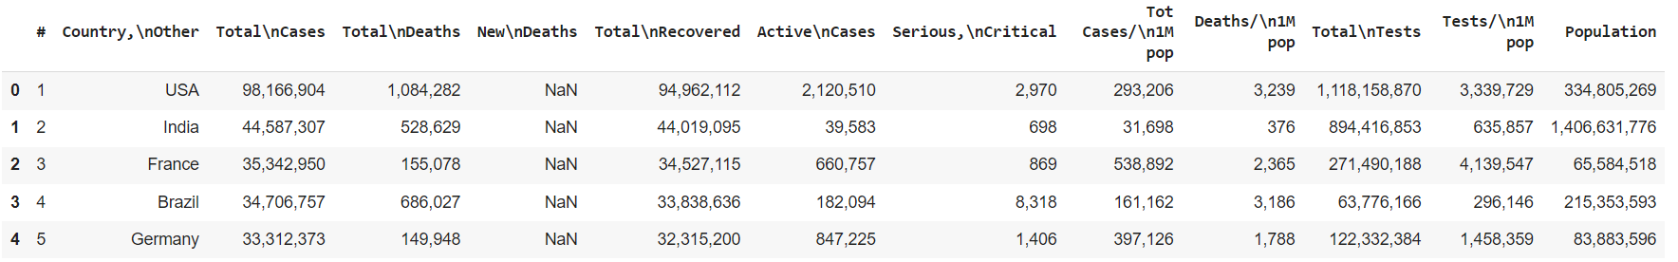
Dataset Overview
The dataset contains COVID-19 statistics for various countries, including information such as total cases, total deaths, total recovered cases, and population size.
3

Slide 4
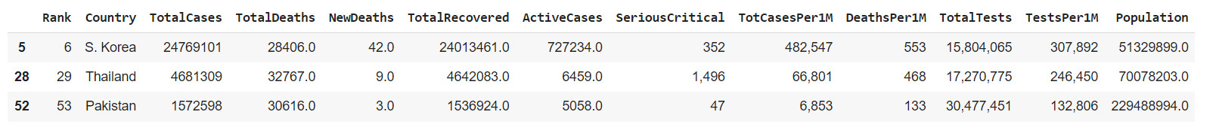
Data Cleaning and Preparation
Steps Taken:
Removed special characters and commas from numeric columns.
Converted columns to numeric types for analysis.
Dropped rows with missing values, resulting in only 3 entries.
4

Slide 5
Exploratory Data Analysis (EDA)
Histograms
Boxplots
5

Slide 6
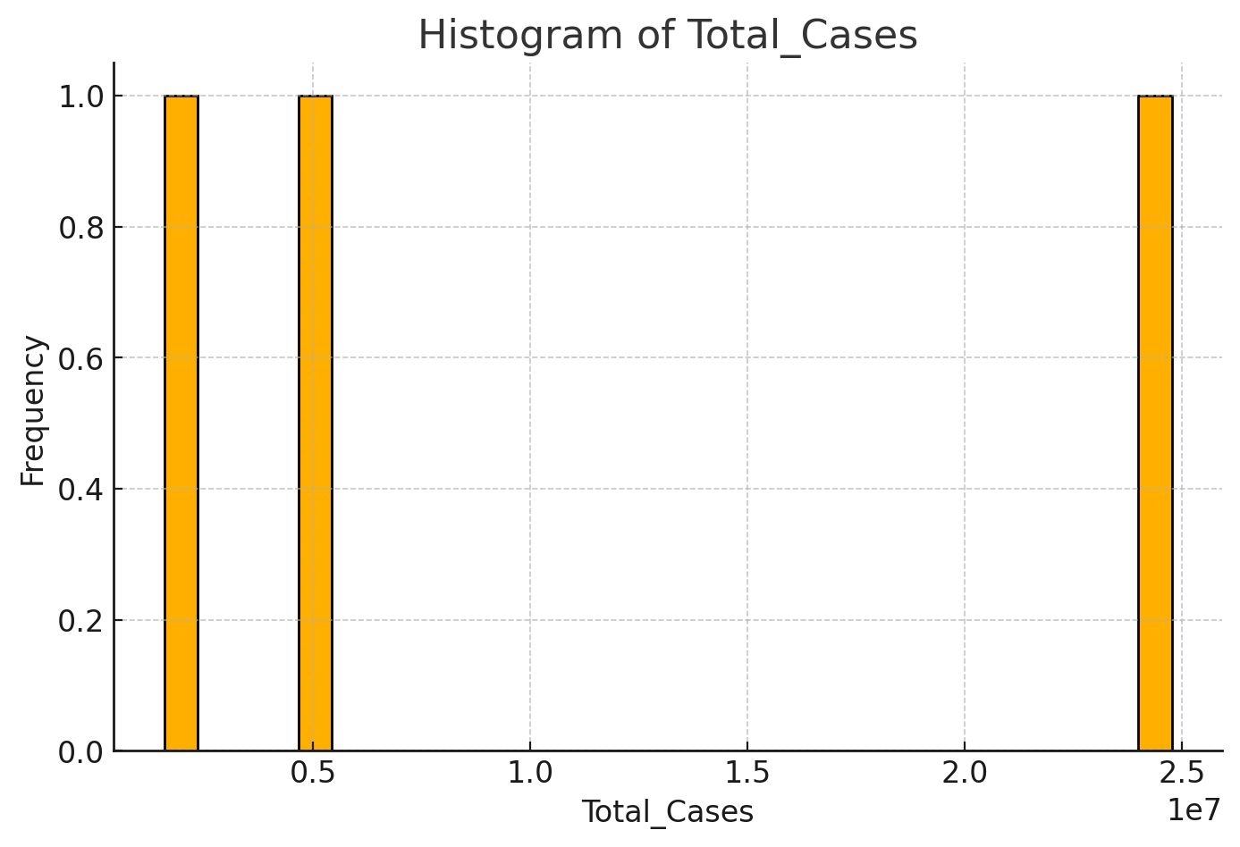
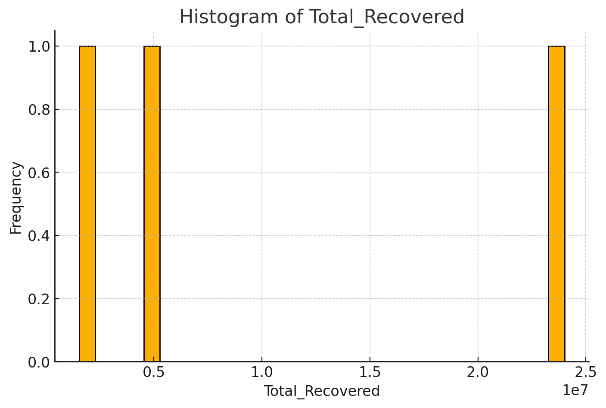
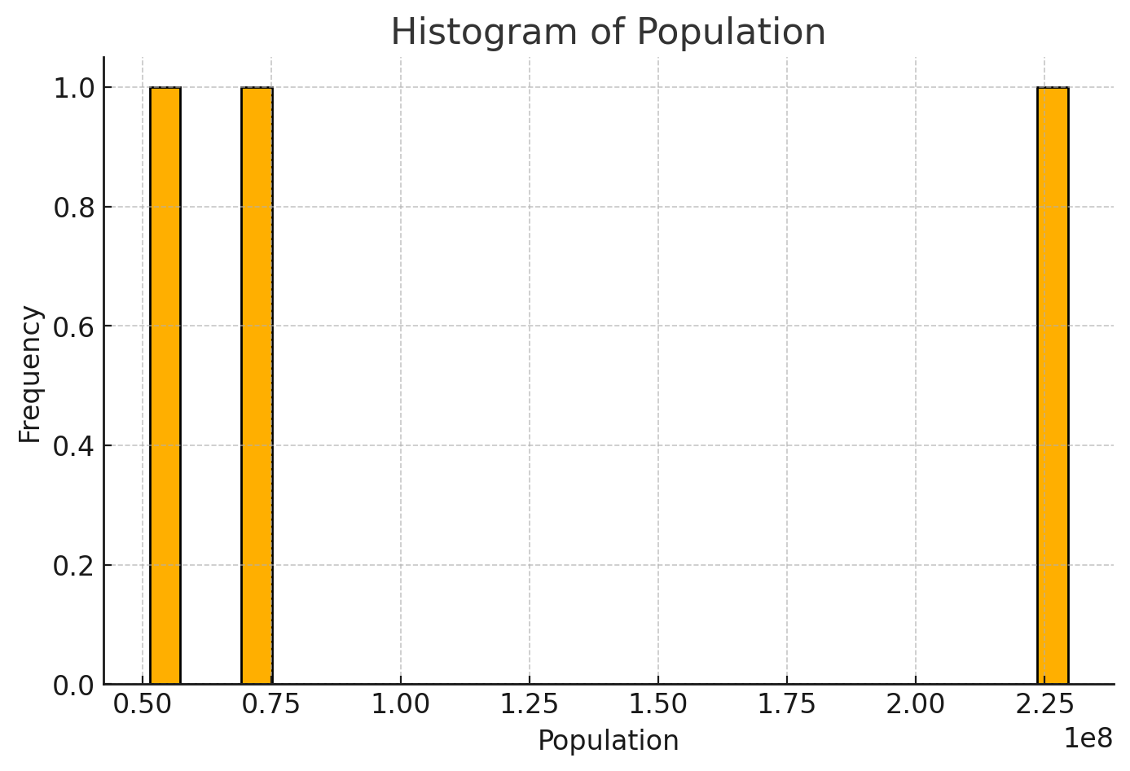
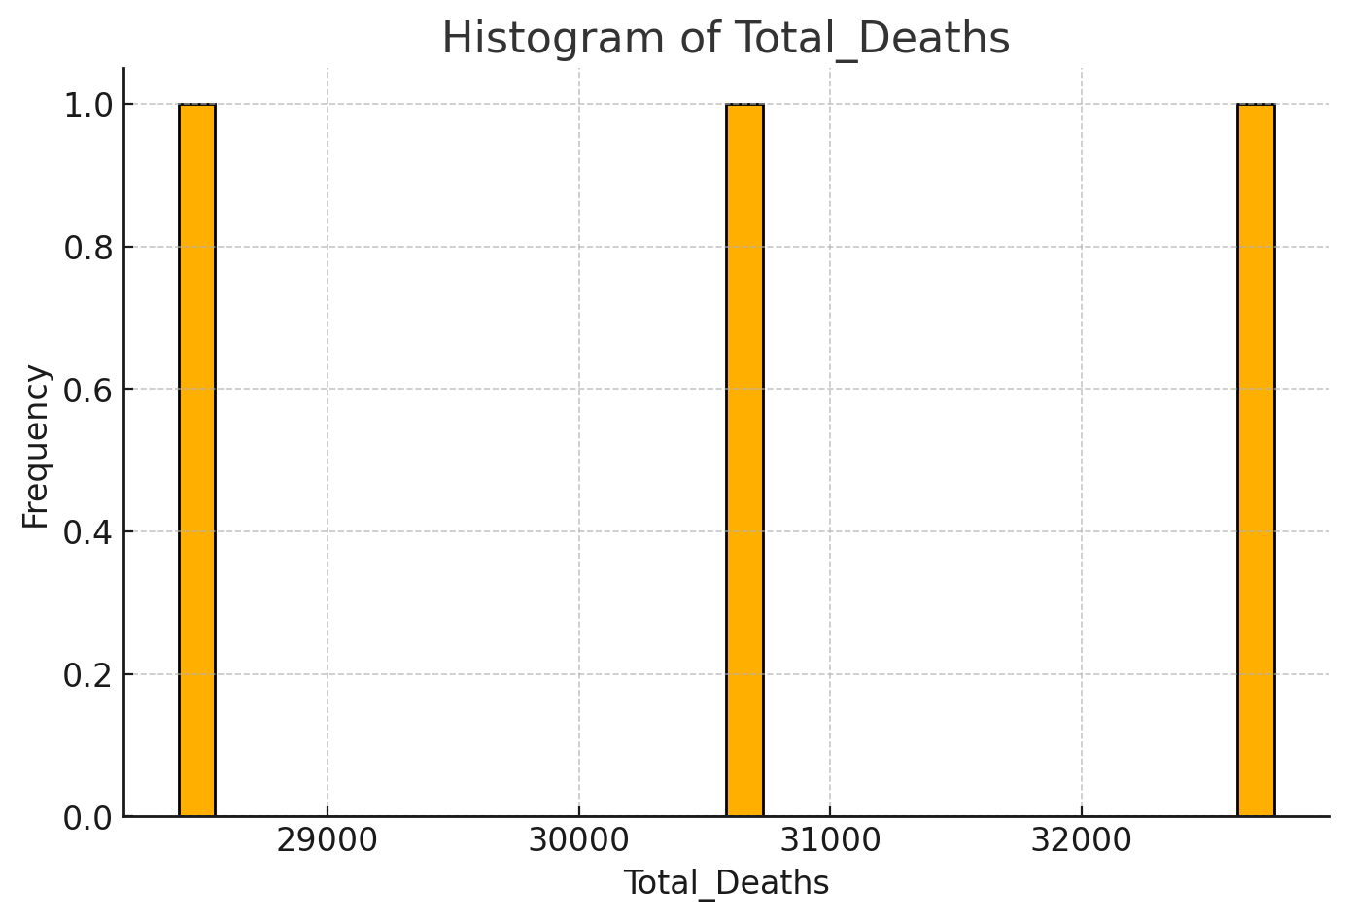
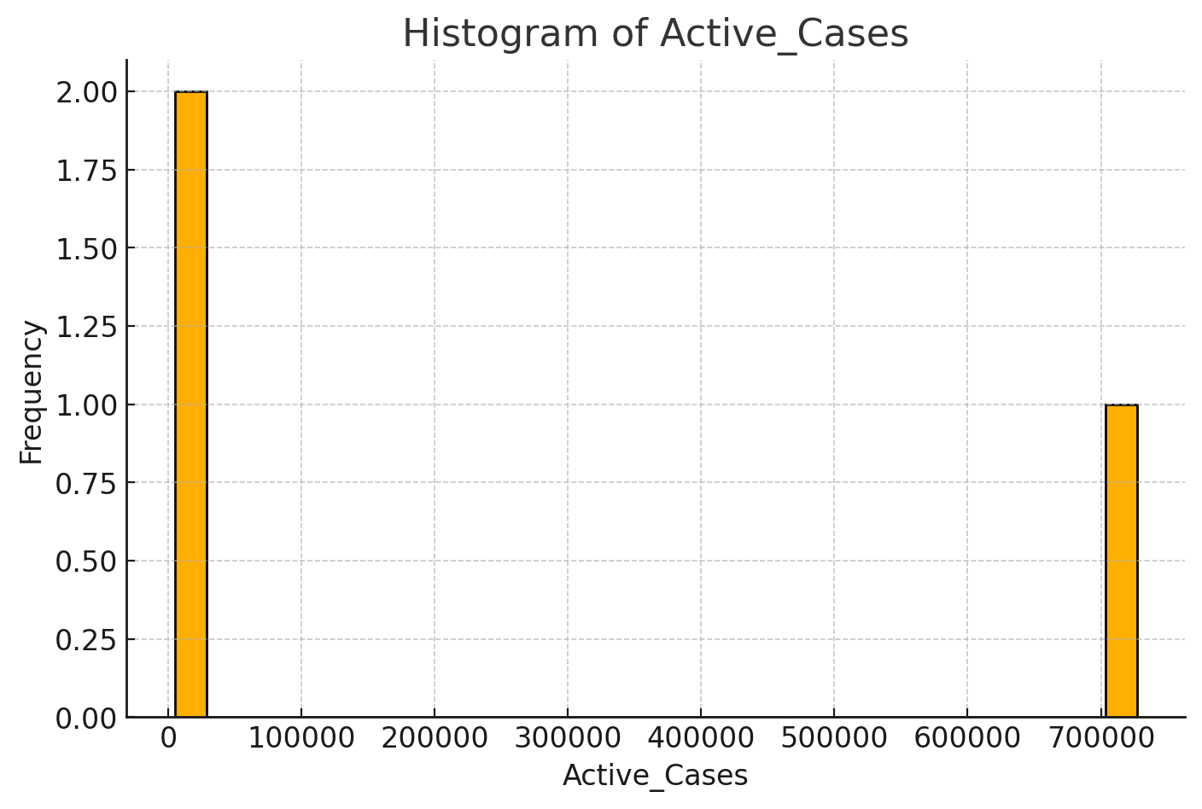
1
6

Slide 7
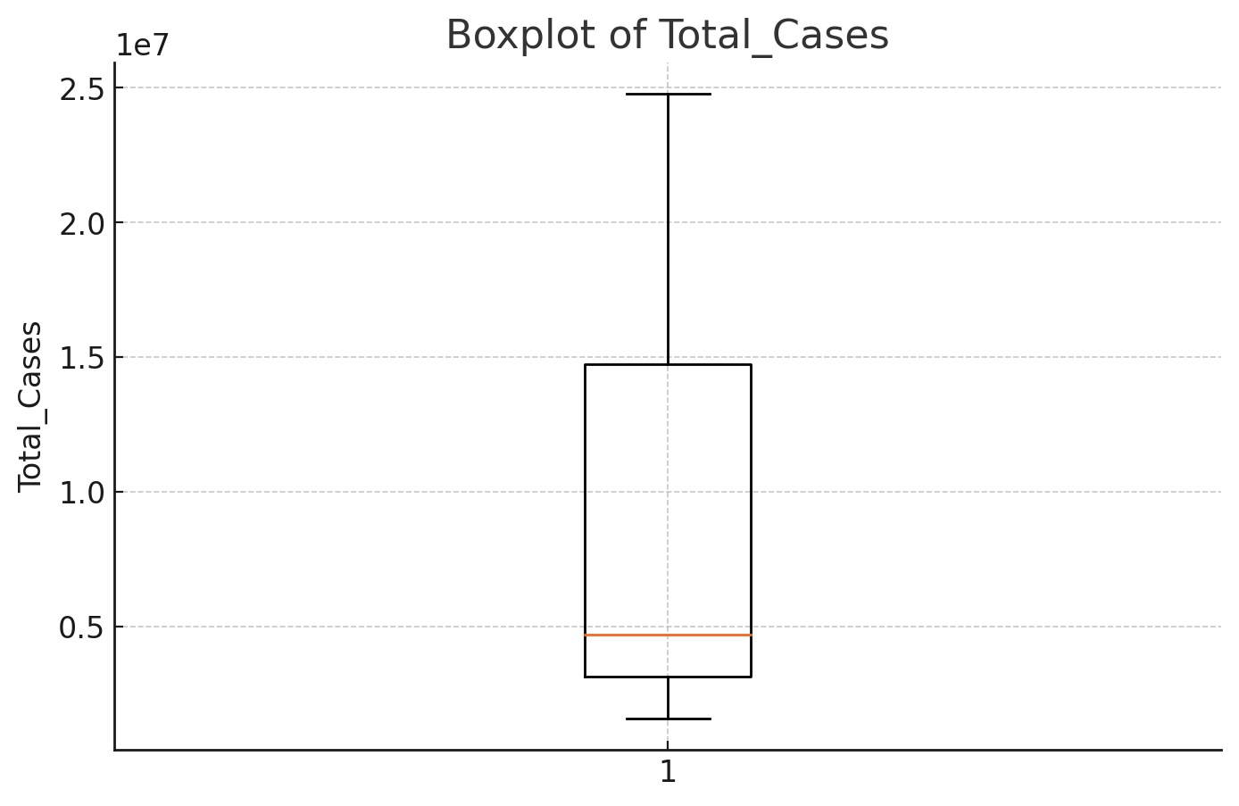
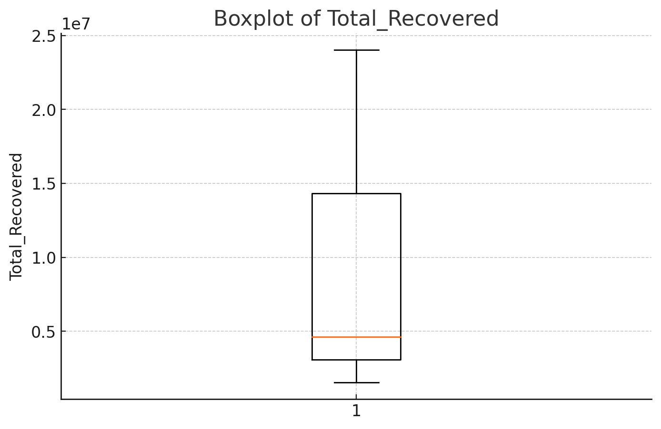
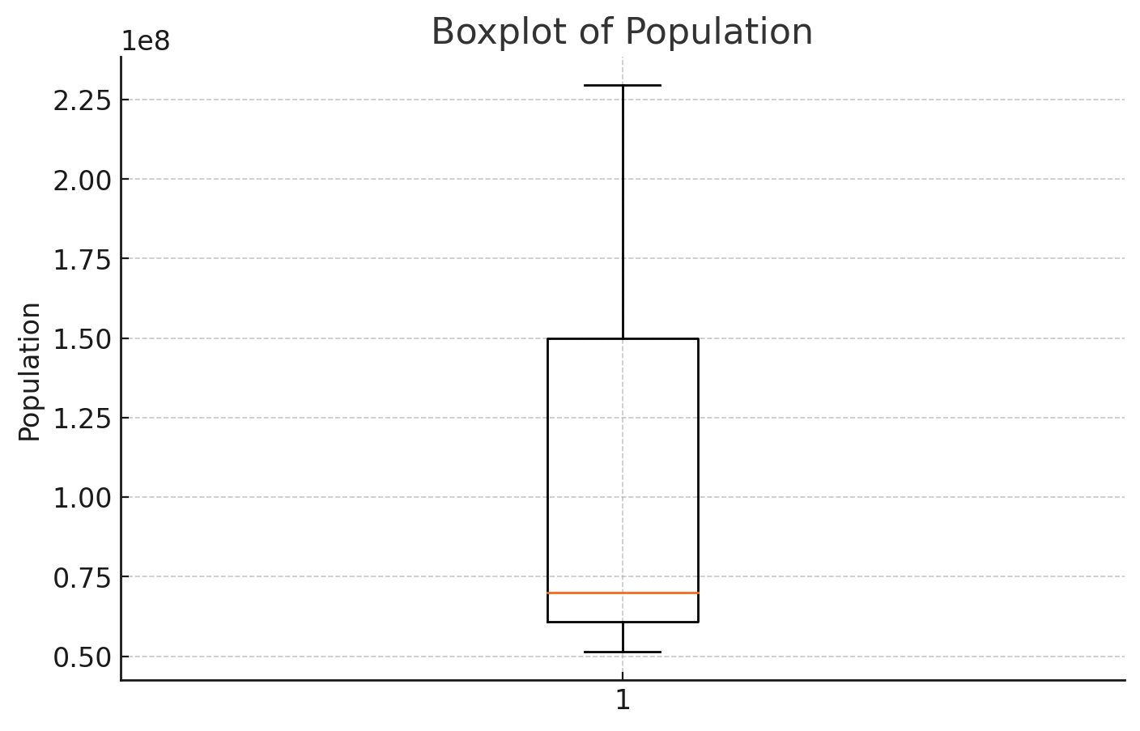
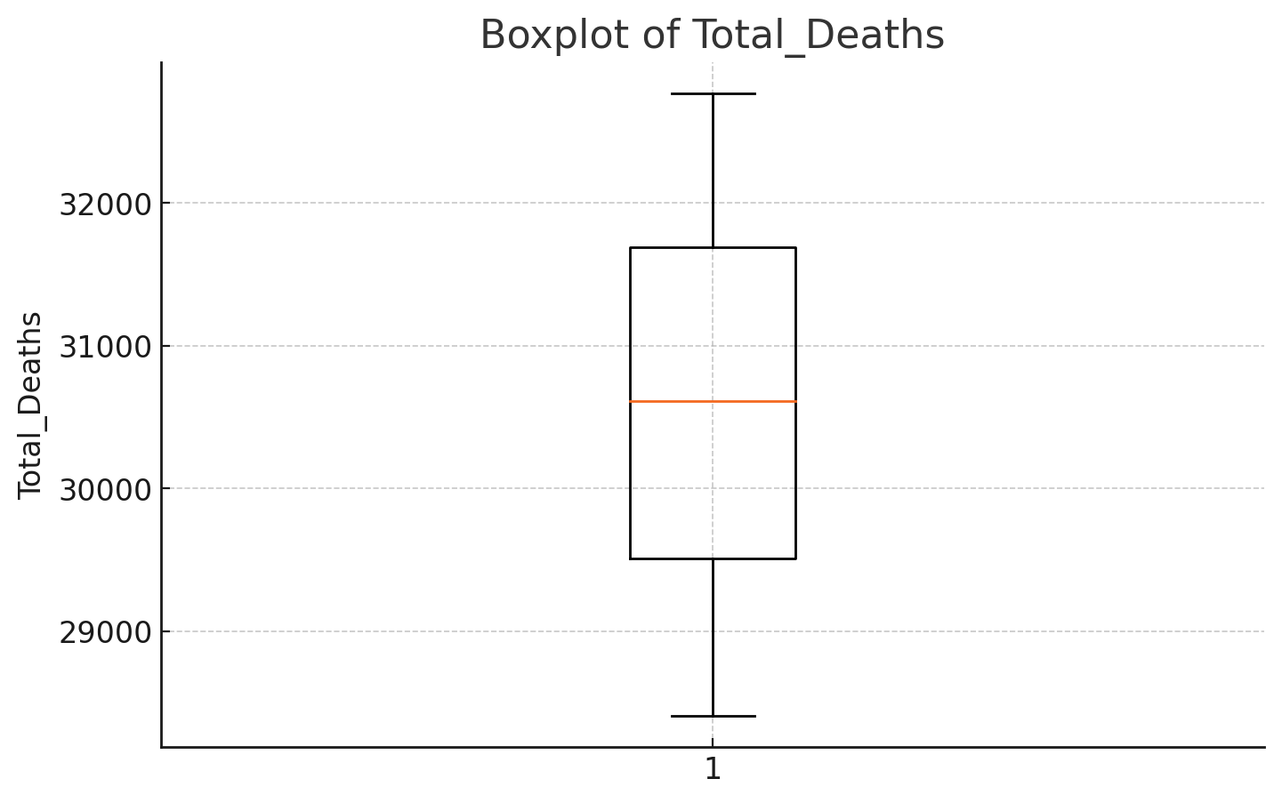
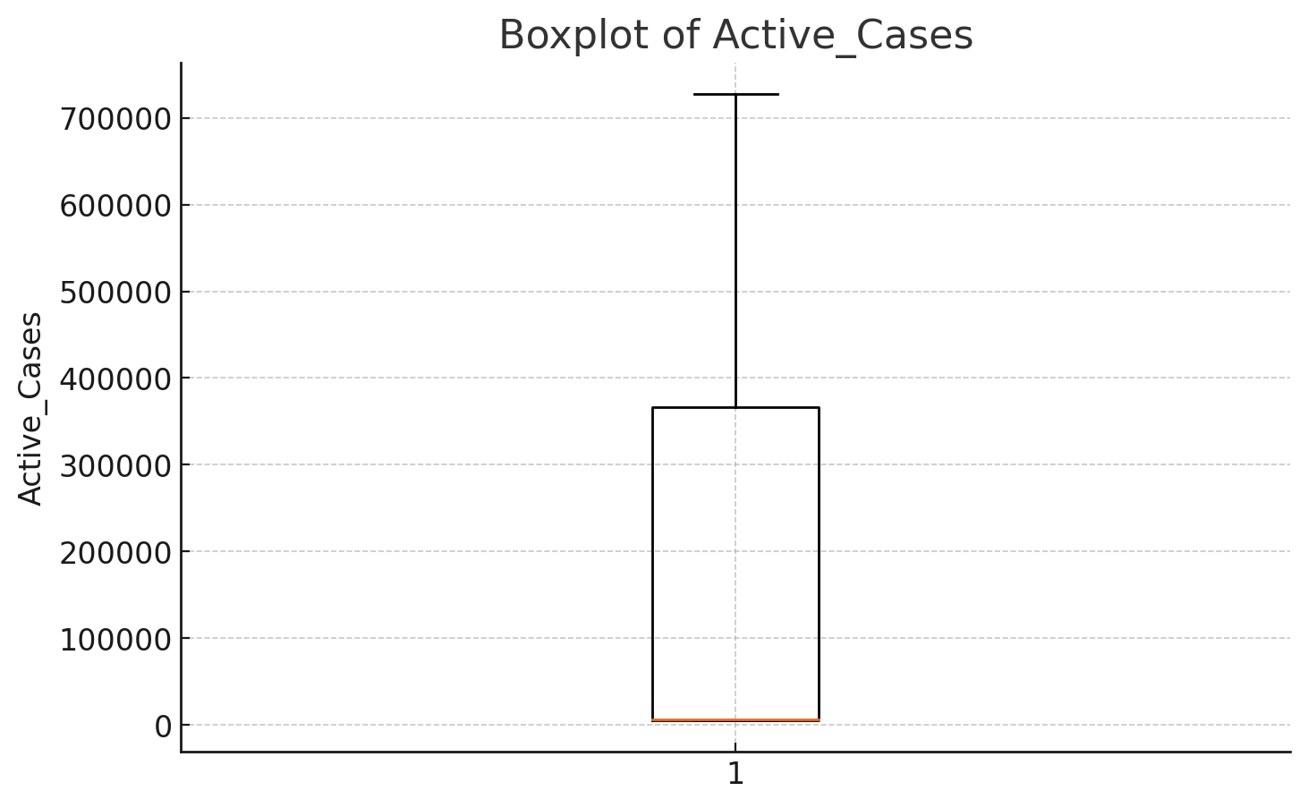
.
7

Slide 8
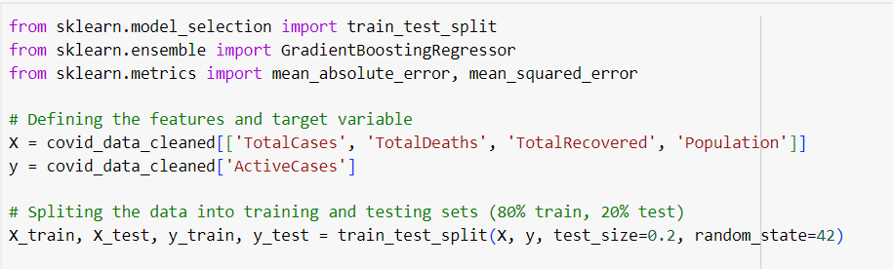
Model Training: Gradient Boosting Regressor
The Gradient Boosting Regressor was selected for this project due to its effectiveness in handling structured data and capturing complex, non-linear relationships.
8

Slide 9
Model Evaluation
The model was evaluated using two regression metrics:
Mean Absolute Error (MAE)
Mean Squared Error (MSE)
9

Slide 10
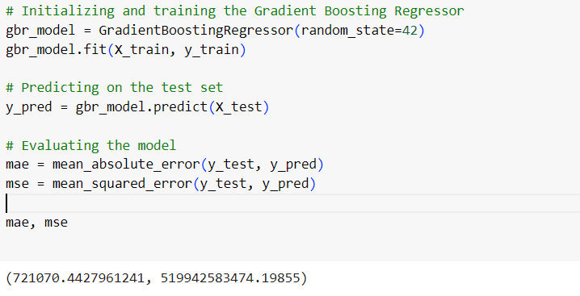
Results
MAE: 721070.44
MSE: 519942583474.20
10

Slide 11

Key Findings
11

Slide 12


Challenges
Insufficient Data
Variability in Country-Specific Data
12

Slide 13
Conclusion
This project aimed to predict COVID-19 active cases using a Gradient Boosting Regressor. While the model was implemented successfully, the limited dataset size significantly impacted its accuracy and reliability.
13

Slide 14
References
https://towardsdatascience.com/linear-regression-using-gradient-descent-97a6c8700931
https://pmc.ncbi.nlm.nih.gov/articles/PMC10244837/
https://en.wikipedia.org/wiki/Gradient_boosting
https://scikit-learn.org/1.5/auto_examples/ensemble/plot_gradient_boosting_regression.html
14

Slide 15
Thank you

